Slide 1
CUSTOMER CHURN PREDICTION AND ANALYSIS

Slide 2
Problem statement –
Study and Identify the reason why customers are churn or attrition (leaving company) based on study suggest strategies to retain customers
Overview –
Churn prediction involves identifying at-risk customers who are likely to cancel their subscriptions or close/abandon their accounts. A churn model works by passing previous customer data through a machine learning model to identify the connections between features and targets and make predictions about new customers.

Slide 3
CustomerID --- Unique customer ID
Churn --- Churn Flag
Tenure --- Tenure of customer in organization
PreferredLoginDevice --- Preferred login device of customer
CityTier --- City tier
WarehouseToHome --- Distance in between warehouse to home of customer PreferredPaymentMode --- Preferred payment method of customer
Gender --- Gender of customer
HourSpendOnApp --- Number of hours spend on mobile application or website NumberOfDeviceRegistered --- Total number of deceives is registered on particular customer PreferedOrderCat --- Preferred order category of customer in last month
SatisfactionScore --- Satisfactory score of customer on service
MaritalStatus --- Marital status of customer Complain --- Any complaint has been raised in last month
OrderAmountHikeFromlastYear --- Percentage increases in order from last year
CouponUsed --- Total number of coupon has been used in last month
OrderCount --- Total number of orders has been places in last month
DaySinceLastOrder --- Day Since last order by customer
CashbackAmount --- Average cashback in last month

Slide 4
PREPROCESSING:
Exploratory Data Analysis
Handling Missing Values
Hypothesis testing
Distribution plots
Encoding
Train test split

Slide 5

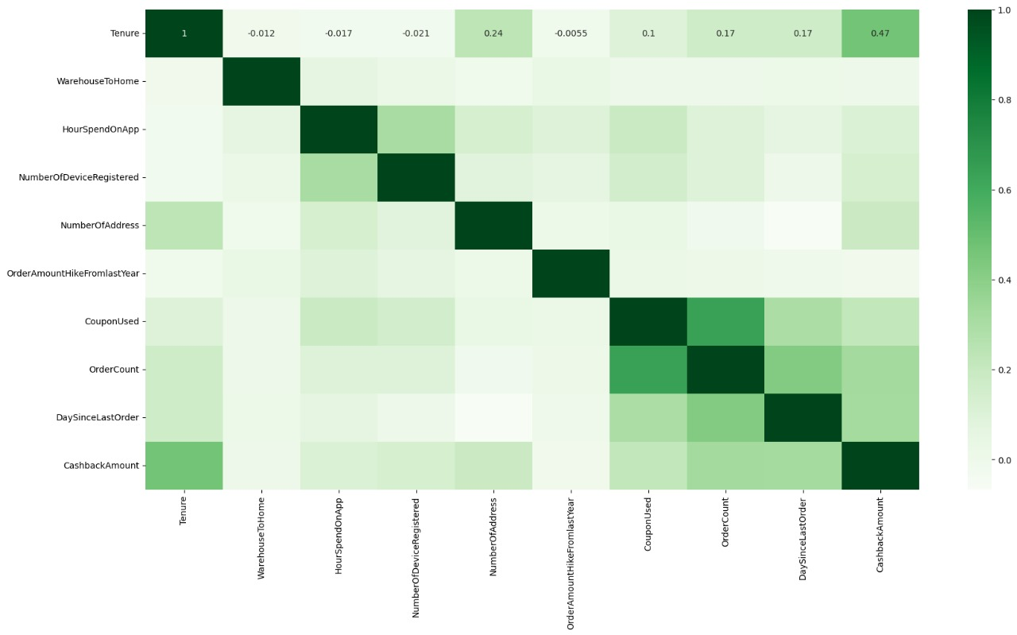
HEAT MAP:

Slide 6
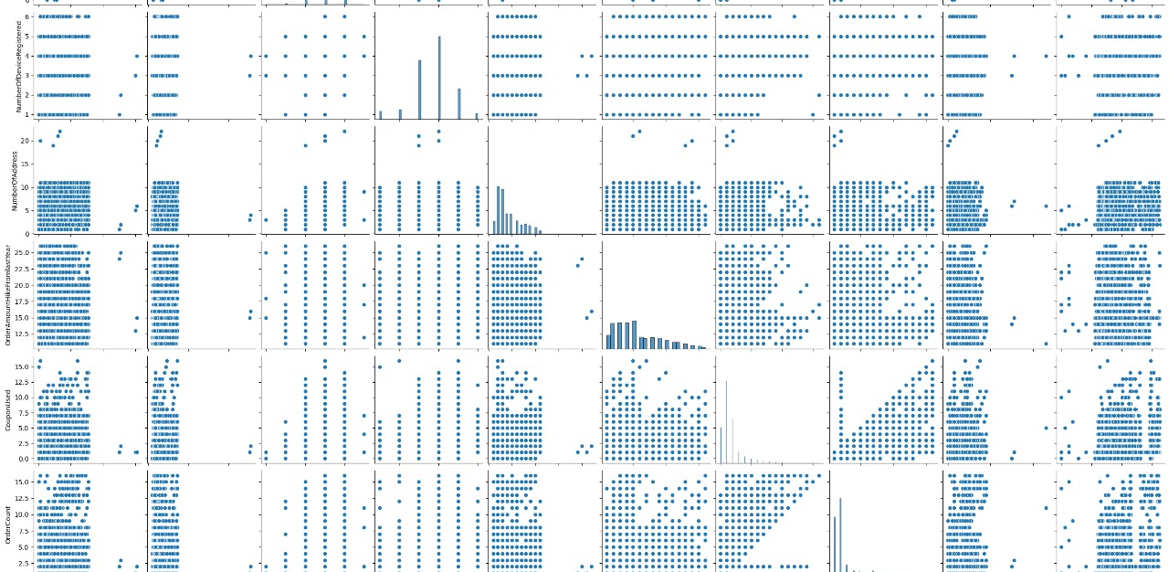
PAIR PLOT:

Slide 7
Model building:
LOGISTIC REGRESSION:
Logistic regression is a statistical method used for binary classification, predicting the probability of an event occurring based on input features.
GRADIENT BOOSTING CLASSIFIER:
Gradient Boosting Classifier is an ensemble machine learning technique that builds a strong predictive model by sequentially combining weak learners, usually decision trees, and correcting errors made by previous models.
KNN:K-Nearest Neighbors (KNN) is a simple algorithm that classifies a data point based on the majority class of its k nearest neighbors in the feature space.
NAIVE BAYES :Naive Bayes is a probabilistic classification algorithm that applies Bayes' theorem with the assumption of independence among features to predict the probability of a class given input features.
RANDOM FOREST :Random Forest is an ensemble learning method that constructs a multitude of decision trees at training time and outputs the class that is the mode of the classes (classification) or mean prediction (regression) of the individual trees.

Slide 8
EVALUATION METRICS:
Classification Report:
A classification report provides precision, recall, and F1-score metrics for each class in a machine learning model's predictions, offering a comprehensive evaluation of its performance.
ROC-AUC CURVE:
ROC AUC curve visually represents the trade-off between true positive rate and false positive rate across different probability thresholds, assessing the discriminatory power of a binary classification model.

Slide 9
Results and Conclusion:
Best Models in terms of accuracy (In my Experiment):
Decision Tree Classifier
Gradient Boost Classifier
Best Models in terms of Computation Time (In my Experiment):
Logistic Regression
KNeighborsClassifier
The ability to predict customer churn is crucial for e-commerce companies to remain competitive.Employing machine learning techniques in customer relationship management can aid companies in forecasting potential customer loss and devising effective marketing and retention strategies.

Slide 10
